Slide 1
seven c’s of effective communication

Slide 2
Group member
Junaid ul Hassan
Ahad ali Zafar
Hamza mehmood
Zainb tahir
Anique khadim
Abdullah ashraf
Daniyal javed
Saad rehman raja

Slide 3
Presented by ahad ali zafar

Slide 4
What is effective communication
Many people want to know what effective communication is. The answer involves several elements. Communicating effectively means that your ideas and concepts are being heard and people are acting upon them. It also means you are able to listen, understand, and take action on what other people say. This is the definition of effective communication and how a department, team or company builds success by understanding what needs to be done and doing it!

Slide 5
What is effective communication today
Good communication today is more difficult than in the past. There are so many more ways to connect, you would think getting your point across would be easier, but that is not the case. With texting, email, instant messaging, faxing, cellular and land line phones, the options are overwhelming. To keep up with and respond to so many sources complicates the process. In addition, the habit of multi-tasking has completely derailed good listening skills as people pay attention far less while trying to do more than one thing.

Slide 6
How we communicate

Slide 7
Prof. Albert Mehrabian of the University of California in Los Angeles said
“The non-verbal elements are particularly important for communicating feelings and attitude, especially when they are incongruent: if words and body language disagree, one tends to believe the body language.”

Slide 8
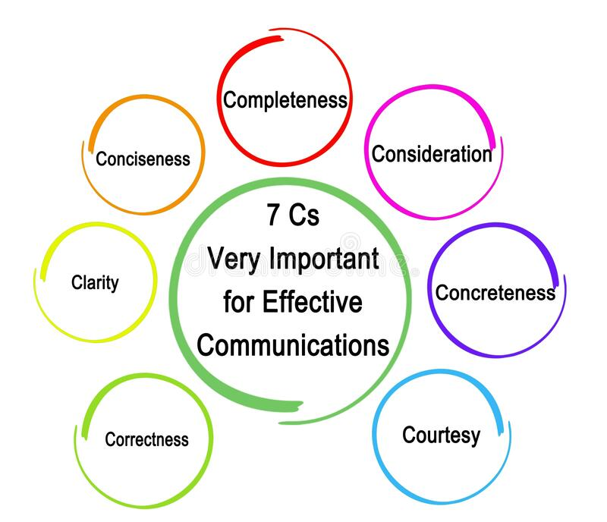

Slide 9
Presented by junaid ul hassan

Slide 10
Completeness
A complete message will have all the information the reader needs to know to be able to respond or take action. If you require the reader to take some kind of action, ensure that you have a ‘call-to-action’ in your email and also communicate the urgency of the task in question. Incomplete messages lead to iterations, a lot of back-and-forth, and waste of time and effort on both ends. Here is an example of an incomplete message.

Slide 11
Provide all necessary information
Answer all the questions
Give some thing extra

Slide 12
Bad example
Hi all,
“Let us meet tomorrow to discuss the product launch event. Please be there on time”
There is no mention of the time of the meeting scheduled for, or the location, neither is there any set agenda. The recipients of the email would have to write back or call back to Chris to clarify.

Slide 13
Good example
The best way
Hi all,
“Let us meet tomorrow at 11 am at Conference room 3 to discuss the product launch event. We will have to decide the keynote speakers and complete the event invite draft tomorrow. Please be there on time”
Thanks

Slide 14
Presented by hamza mehmood

Slide 15
clarity
Any message needs to come out clearly from your communication rather than the recipient having to assume things and coming back to you for more information. This will only lead to more time being wasted on emails.
Do not try to communicate too many things in one message. This will dilute the attention of the reader. For an example of poor communicating skills, look at this email below

Slide 16
Bad example
Dear James,
“I would like to talk to you about the new client’s project which the engineering team had discussed yesterday. I might need the help of John from your team”
There are innumerable things that are wrong in this message. James might not even know who the new client is or what the project is about. He probably was not part of the meeting with the engineering team. Furthermore, there might be more than one John in James’ big team. Kevin also mentions that he wants to talk. However, he hasn’t mentioned what time he would like to talk, neither has he asked James if he would be free at any of the time slots available.
Here’s how this email could be made clearer.

Slide 17
Good example
Hey James,
“As you may know we have signed up XYZ as our new client. I had a meeting with the engineering team yesterday and had discussed the campaign requirements for this project. John Redden from your team had done a pretty good job last time doing the social media campaign for ABC and so I would like him to work on the XYZ campaign too. Would you be available sometime tomorrow to discuss this further?”
This message has all the information James needs to know. He can be well prepared for the meeting and also check on John’s availability and have an answer for Kevin when they meet the next day – in whichever time slot both the men are free.

Slide 18
Presented by daniyal javed

Slide 19
Correctness
Correctness in communication implies that there are no grammatical errors in communication. Correct communication has following features:
The message is exact, correct and well-timed.
If the communication is correct, it boosts up the confidence level.
Correct message has greater impact on the audience/readers.
It checks for the precision and accurateness of facts and figures used in the message.
It makes use of appropriate and correct language in the message.
Awareness of these 7 C’s of communication makes you an effective communicator.

Slide 20
Bad example
Dear David,
“Further to our conservation today, I am attaching the plan for the first stage of the project. Hope the one weak deadline is okay with you and your team”
There were two glaring spelling errors in this message. ‘Conversation’ was spelled ‘conservation’ and ‘week’ was spelled ‘weak’. Though these are minor errors, they could gravely impact the credibility of your professionalism and the brand image of the organization you represent

Slide 21
Good example
Hi Nam,
“Thanks for submitting the industry report. Finn will give you some feedback on it. You will be receiving an email from him with detailed comments”.
In this example there are no spelling mistake and no any grammar mistake during convey message.

Slide 22
Presented by zainb tahir

Slide 23
Conciseness
People more often than not tend to say 4 sentences in a place where they could have finished the message in 2 sentences. This wastes the time of the sender and the receiver and in turn limits their productivity too. Furthermore, try not to add fillers such as ‘I mean’, ‘sort of’, ‘for instance’, ‘basically’, etc. Your message needs to be accurate, to the point and crisp. Here is an example of a bad message

Slide 24
t is both time-saving as well as cost-saving.
It underlines and highlights the main message as it avoids using excessive and needless words.
Concise communication provides short and essential message in limited words to the audience.
Concise message is more appealing and comprehensible to the audience.
Concise message is non-repetitive in nature.

Slide 25
Bad example
Hi Ayesha,
“I think we need to talk about the CSR campaign, I mean the one which we need to do as a quarterly exercise. I think it is a great way of enhancing our brand image. Basically, it would just be a visit to an orphanage but we can sort of do other things too. For instance, we could take the kids out for a short trip to a nearby park or zoo. Let us sit and talk tomorrow”.
The message is full of fillers and extended phrases wherein she could have finished the message in just two sentences, such as the one below.

Slide 26
Good example
Hi Ayesha,
I need to discuss the quarterly CSR campaign with you. Let us take the kids out this time to a nearby park or zoo instead of just visiting them. This will help enhance our brand image. We’ll talk in detail tomorrow.

Slide 27
presented by Saad Rehman raja

Slide 28
Consideration
Consideration implies “stepping into the shoes of others”. Effective communication must take the audience into consideration, i.e., the audience’s view points, background, mind-set, education level, etc. Make an attempt to envisage your audience, their requirements, emotions as well as problems. Ensure that the self-respect of the audience is maintained and their emotions are not at harm. Modify your words in message to suit the audience’s needs while making your message complete. Features of considerate communication are as follows:

Slide 29
Emphasize on “you” approach.
Empathize with the audience and exhibit interest in the audience. This will stimulate a positive reaction from the audience.
Show optimism towards your audience. Emphasize on “what is possible” rather than “what is impossible”. Lay stress on positive words such as jovial, committed, thanks, warm, healthy, help, etc.

Slide 30
Bad example
Hi Arslan,
“Thanks for submitting the industry report. Finn will give you some feedback on it. Finn also wanted to find out if you will be available for the client meeting tomorrow. We will be discussing the budget for the next phase of the project”
The email was supposed to be about the industry report which was submitted and the feedback for it. The question about the meeting had come out of nowhere and will now distract Nam and her priorities.

Slide 31
good example
Hi Arslan,
“Thanks for submitting the industry report. Finn will give you some feedback on it. You will be receiving an email from him with detailed comments”.
he talks only about the report. Therefore, Arslan knows that her report has been viewed and she needs to wait for feedback. There are no other distractions. The query about the meeting must have been an entirely different message.

Slide 32
Presented by Abdullah ashraf

Slide 33
courtesy
Courtesy in message implies the message should show the sender’s expression as well as should respect the receiver. The sender of the message should be sincerely polite, judicious, reflective and enthusiastic. Courteous message has following features:
Courtesy implies taking into consideration both viewpoints as well as feelings of the receiver of the message.
Courteous message is positive and focused at the audience.
It makes use of terms showing respect for the receiver of message.
It is not at all biased.

Slide 34
bad example
Hi Hassan,
“I really do not appreciate how your IT team ignores the requests of my team alone. My team is an important function in this organization too and we have our own IT requirement. Can you ensure that your team responds promptly to my team’s requests hereon?”
This way of communication is condescending, judgmental, and disrespectful. Drew might now order his team to not respond to your team’s requirements entirely. Try this instead:

Slide 35
Good example
Hi Hassan,
“I understand that the IT team is swamped with work and gets requests from every department in the organization. My team, however, is working on a high-priority project and I would greatly appreciate if you could ask your team members to respond to my team’s queries promptly and help us complete this project on time. Please do let me know if you need anything from me”.
As a result of the polite request, it is likely that Drew will feel appreciated and important and he will definitely ask his team to help your team out. Work gets done and everybody is happy too.

Slide 36
Presented by anique khadim

Slide 37
Concreteness
Concrete communication implies being particular and clear rather than fuzzy and general. Concreteness strengthens the confidence. Concrete message has
You need to believe in you what you want to convey to the audience. Concreteness is a quality which needs to come to the fore especially during marketing or advertising campaigns. There need to be details that capture the attention of the audience, not bore them.

Slide 38
It is supported with specific facts and figures.
It makes use of words that are clear and that build the reputation.
Concrete messages are not misinterpreted.

Slide 39
bad example
“Hilltop Resort is the best resort. Do come to us on your next holiday”
This is a vague ad message. It is made to sound like just another resort advertisement among a hundred others. The audience will never remember this ad message. There are no concrete details to take away from this message.

Slide 40
Good example
“Hilltop Resort is the jewel of the western hills. Take a break from your work. Escape from life’s chaos and stress. Relax and rejuvenate yourself at Hilltop. Go back fresh and energized!”
This message gives you visualizing details. The reader can actually imagine being in a beautiful resort breathing fresh air and swimming in a pool instead of slogging away at his or her office. That is a concrete message conveyed to the audience.

Slide 41
conclusion
To sum up, working with other individuals, be it within your team or other teams in the organization is the norm in today’s corporate setting. Therefore, communication becomes a critical skill. When you communicate well, you become more efficient, you tend to command respect among your peers and you maintain a healthy relationship with your colleagues. Keep in mind the 7 Cs of effective communication and accelerate your career growth.

Slide 42
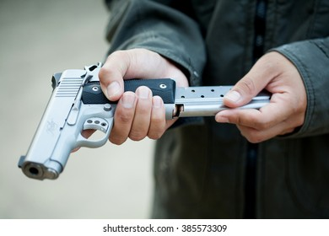
any question ?

Slide 43
Thank you

